Slide 1
FLIPROBO TECHNOLOGIES
TELECOM MICRO CREDIT MODEL
Submitted by:- Twinkle Patel

Slide 2
PROBLEM STATEMENT
A Microfinance Institution (MFI) is an organization that offers financial services to low income populations. MFS becomes very useful when targeting especially the unbanked poor families living in remote areas with not much sources of income. The Microfinance services (MFS) provided by MFI are Group Loans, Agricultural Loans, Individual Business Loans and so on.
Many microfinance institutions (MFI), experts and donors are supporting the idea of using mobile financial services (MFS) which they feel are more convenient and efficient, and cost saving, than the traditional high-touch model used since long for the purpose of delivering microfinance services. Though, the MFI industry is primarily focusing on low income families and are very useful in such areas, the implementation of MFS has been uneven with both significant challenges and successes.
Today, microfinance is widely accepted as a poverty-reduction tool, representing $70 billion in outstanding loans and a global outreach of 200 million clients.

Slide 3
We are working with one such client that is in Telecom Industry. They are a fixed wireless telecommunications network provider. They have launched various products and have developed its business and organization based on the budget operator model, offering better products at Lower Prices to all value conscious customers through a strategy of disruptive innovation that focuses on the subscriber.
They understand the importance of communication and how it affects a person’s life, thus, focusing on providing their services and products to low income families and poor customers that can help them in the need of hour.
They are collaborating with an MFI to provide micro-credit on mobile balances to be paid back in 5 days. The Consumer is believed to be defaulter if he deviates from the path of paying back the loaned amount within the time duration of 5 days. For the loan amount of 5 (in Indonesian Rupiah), payback amount should be 6 (in Indonesian Rupiah), while, for the loan amount of 10 (in Indonesian Rupiah), the payback amount should be 12 (in Indonesian Rupiah).
The sample data is provided to us from our client database. It is hereby given to you for this exercise. In order to improve the selection of customers for the credit, the client wants some predictions that could help them in further investment and improvement in selection of customers.

Slide 4
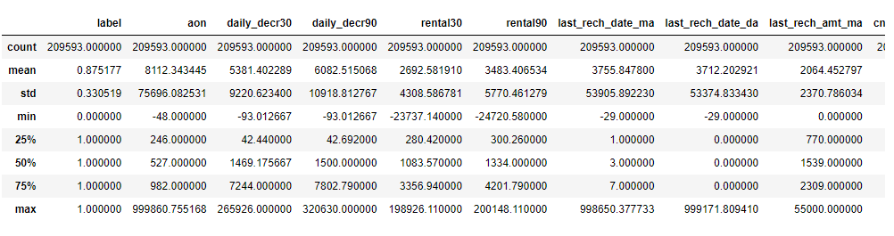
Analytical Problem Framing
We can see that the min value is negative which is not even possible for most of the features like daily recharge and main account balance, and last recharge can't be negative.
We created multiple group based on min, 25% to 75%, above 75% and we compared VS payback within 5 days.

Slide 5
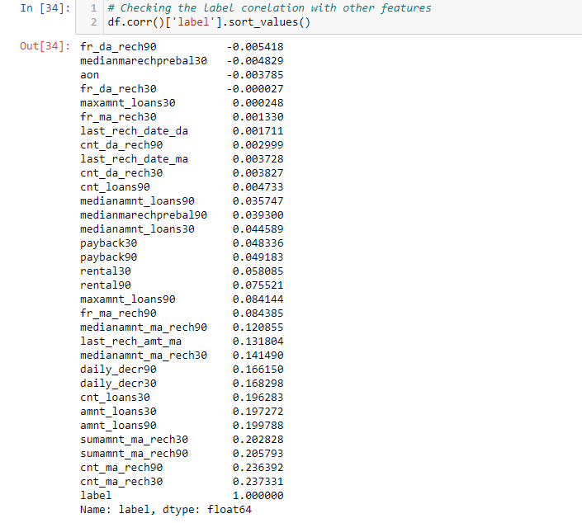
Correlation
The table shows the Correlation of the target variable with other variables.
The less correlated variables can be removed from the final dataframe.

Slide 6
Data Preprocessing
We created multiple groups based on min, 25% to 75%, above 75% and we compared it VS payback within 5 days.
We identified the outliers for features whose Z-score>5, and then did mean imputing and also applied cube root to bring the data closer to distribution.
We checked the correlation of the independent and dependent features and dropped the negative and less important features with the help of correlation matrix.
Applied StandardScaler to our dependent features.

Slide 7
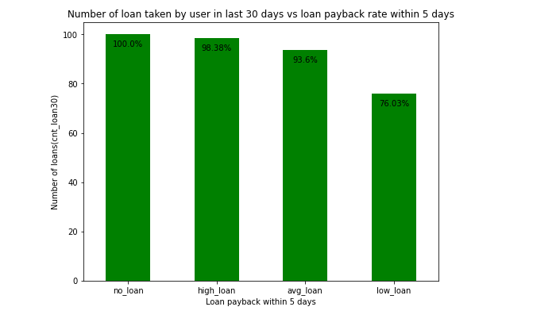
Visualisation
we can see that majority user who took high loans in last 30 days are more likely to payback within 5 days and 1.62% users failed to payback within 5 days, and among average loan user 7% users failed to pay back the loan within 5 days, and users with low loan have 24% didn't payback as expected might be defaulted.

Slide 8
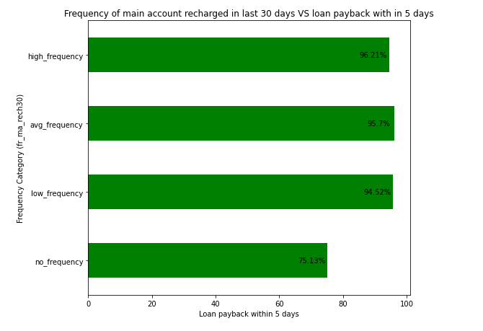
we can see there are no 100% rate in any frequency group to payback the loan within 5 days, and all average low and high frequency have at least 6% to 4% users didn't payback the loan within 5 days. Coming to user have no frequency 25% users didn't payback the loan with in 5 days, till now we can see that users with no balance and no frequency are costing huge losses.

Slide 9
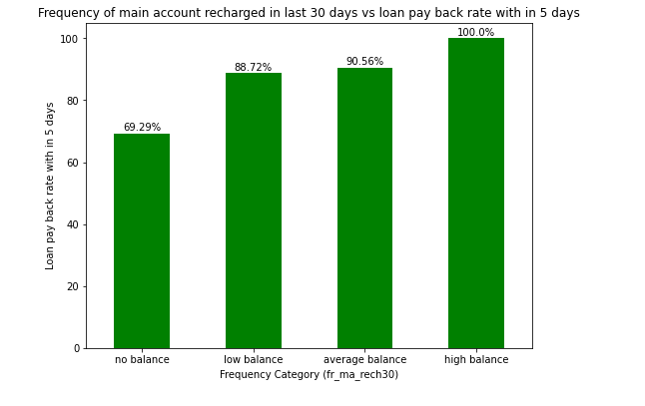
From the above we can see that users with high balance always pays back the loan within 5 days and average and low category only 9% - 12% users failed to payback the loan within 5%, and users with zero balance around 30% users are not paying the loan back within 5 days.

Slide 10
Model Development
Testing of Identified Approaches (Algorithms) Accuracy
GradientBoostingClassifier()-
DecisionTreeClassifier() -
RandomForestClassifier()-
LogisticRegression() -
KNeighborsClassifier()-
GaussianNB()-
74
95
97
75
87
65

Slide 11
CONCLUSION
So from this project I learned how apart from a traditional loan problem,there are credit related problems revolving around other sectors too like in this case it was telecom industry,this model classified the loans given to the users were paid back within 5 days or not,so this was a great move and with data science the telecom company can study the behaviour of users ,how much loan they can take and thereby identifying there potential users also providing these types of credit to all incomes groups especially poor, by giving easy and small amount of loans which are easy to repay.

